Slide 1

Amazon DynamoDB
GTech

Slide 2
Content
Introduction to Amazon DynamoDB
What is Amazon DynamoDB?
Understanding Tables, Items, and Attributes
Primary Key: Partition Keys and Sort Keys
How Applications Read and Write Data
Capacity, Performance and Scalability
Secondary Indexes: GSI and LSI
How DynamoDB Support Generative AI Application
DynamoDB Vector Indexes and Similarity Search
Summary

Slide 3
Introduction to Amazon DynamoDB
Fully managed NoSQL database service from AWS
Stores and retrieves data with low latency
Supports key-value and document data models
AWS manages the underlying database infrastructure
Scales to support changing application workloads.
Used in web apps, mobile apps, chatbots, and AI agents

Slide 4
What is Amazon DynamoDB
A fully managed, serverless NoSQL database
Stores data as items and attributes
Does not require direct server management
Supports flexible data structure
Provides features for availability and durability
Useful for sessions, profiles, shopping carts and AI memory

Slide 5
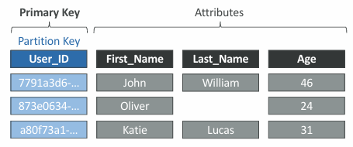
Tables, Items, and Attributes
Table: A collection of related data
Item: One individual record in a table
Attribute: A piece of information about an item
Every item must contain the required primary-key attributes
Other attributes can vary between items

Slide 6
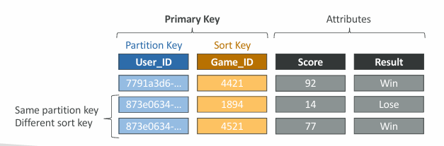
Primary Keys: Partition Key and Sort Key
A primary key uniquely identifies and item
Partition Key: Support data distribution and item lookup
A simple primary key uses only a partition key
A composite primary key uses a partition key
A composite primary key uses a partition key and sort key
Sort keys help organize related items
Choose keys based on how the application retrieves data

Slide 7
Reading and Writing Data
Applications connect through AWS APIs and SDKs
PutItem: creates or replace an item
GetItem: Retrieves an item using its complete primary key
UpdateItem: Updates item attributes or creates an item if needed
DeleteItem: Removes an item
Query finds items by partition key

Slide 8
Capacity, Performance, and Scalability
DynamoDB offers on-demand and provisioned capacity modes
On-demand: Pay based on request usage
Provisioned: specify expected read and write capacity
Auto scaling can adjust provisioned capacity
RCU and WCU describe read and write capacity
Good key design and monitoring help manage performance

Slide 9
Secondary Indexes: GSI and LSI
Secondary indexes provide additional ways to query data
GSI: Can use a different partition key and optional sort key
LSI: Uses the same partition key but a different sort key
Indexes support additional query patterns.
Indexes require additional storage and may add cost
Create indexes based on the application’s actual needs.

Slide 10
Important DynamoDB Features
DynamoDB Streams: Captures changes to table items
Time to Live (TTL): Expires eligible items automatically
Global Tables: Replicate data across AWS Regions
Point-in-time recovery: Helps restore data to an earlier point
Encryption at rest helps protect stored data

Slide 11
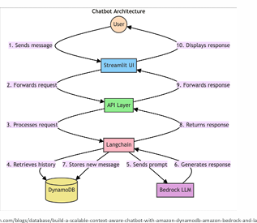
DynamoDB in Generative AI Applications
Stores chatbot conversation history and session details
Can store summaries for AI agent memory
Saves application state and workflow progress
Stores feedback about AI-generated responses
Integrates with services such as Amazon Bedrock and AWS Lambda

Slide 12
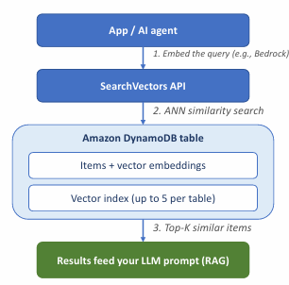
Vector Indexes and Similarity Search
Embedding: A numerical representation of information
Similar meanings may produce nearby vectors
Vector indexes support searches for similar information
DynamoDB vector search can retrieve relevant items
Distance measures can include cosine and dot product
Vector retrieval can support semantic search and RAG

Slide 13
Summary
DynamoDB is a fully managed NoSQL database service
Tables contain items, and items contain attributes
Primary-keys design influences data access
Choose capacity modes based on workload needs
Use indexes and additional features when appropriate
DynamoDB can support AI memory and vector-based retrieval

Slide 14


